Slide 1
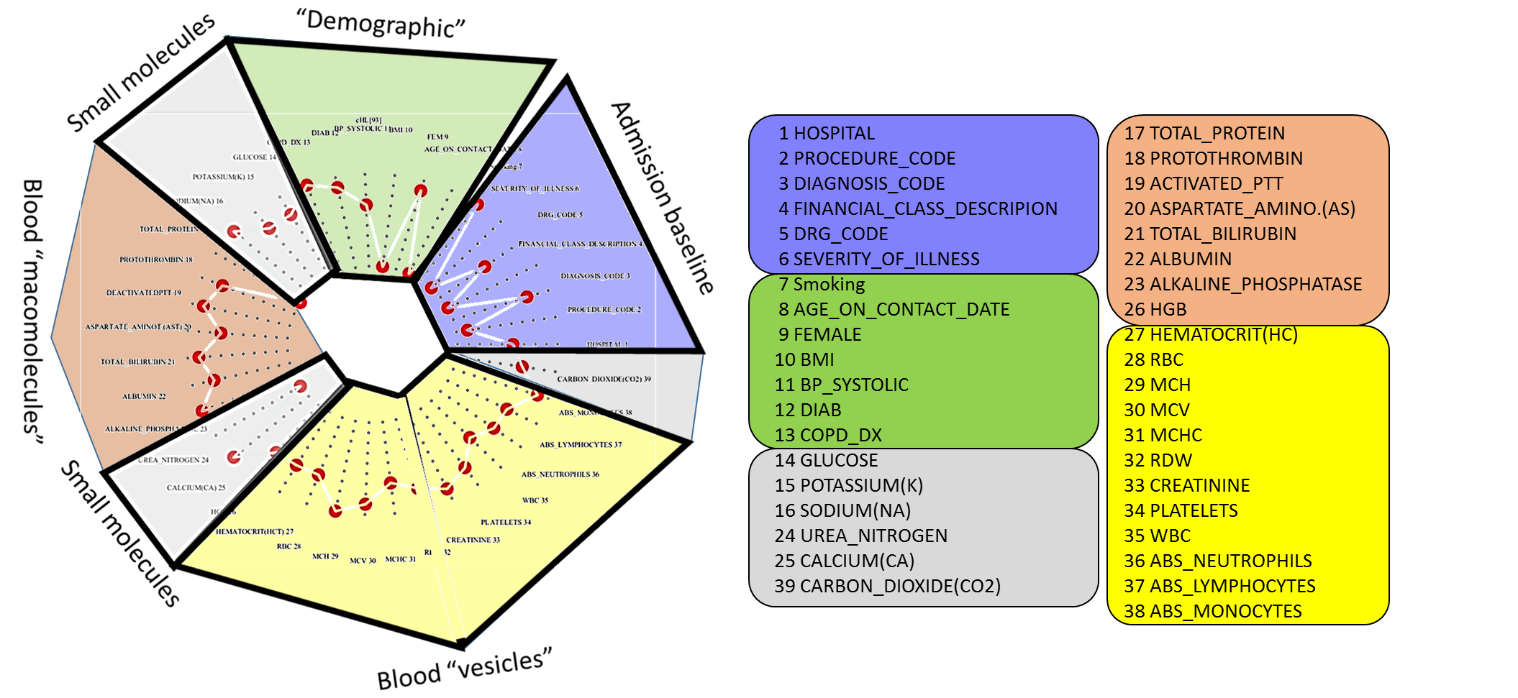
Categories of information for lung cancer surgery project

Slide 2
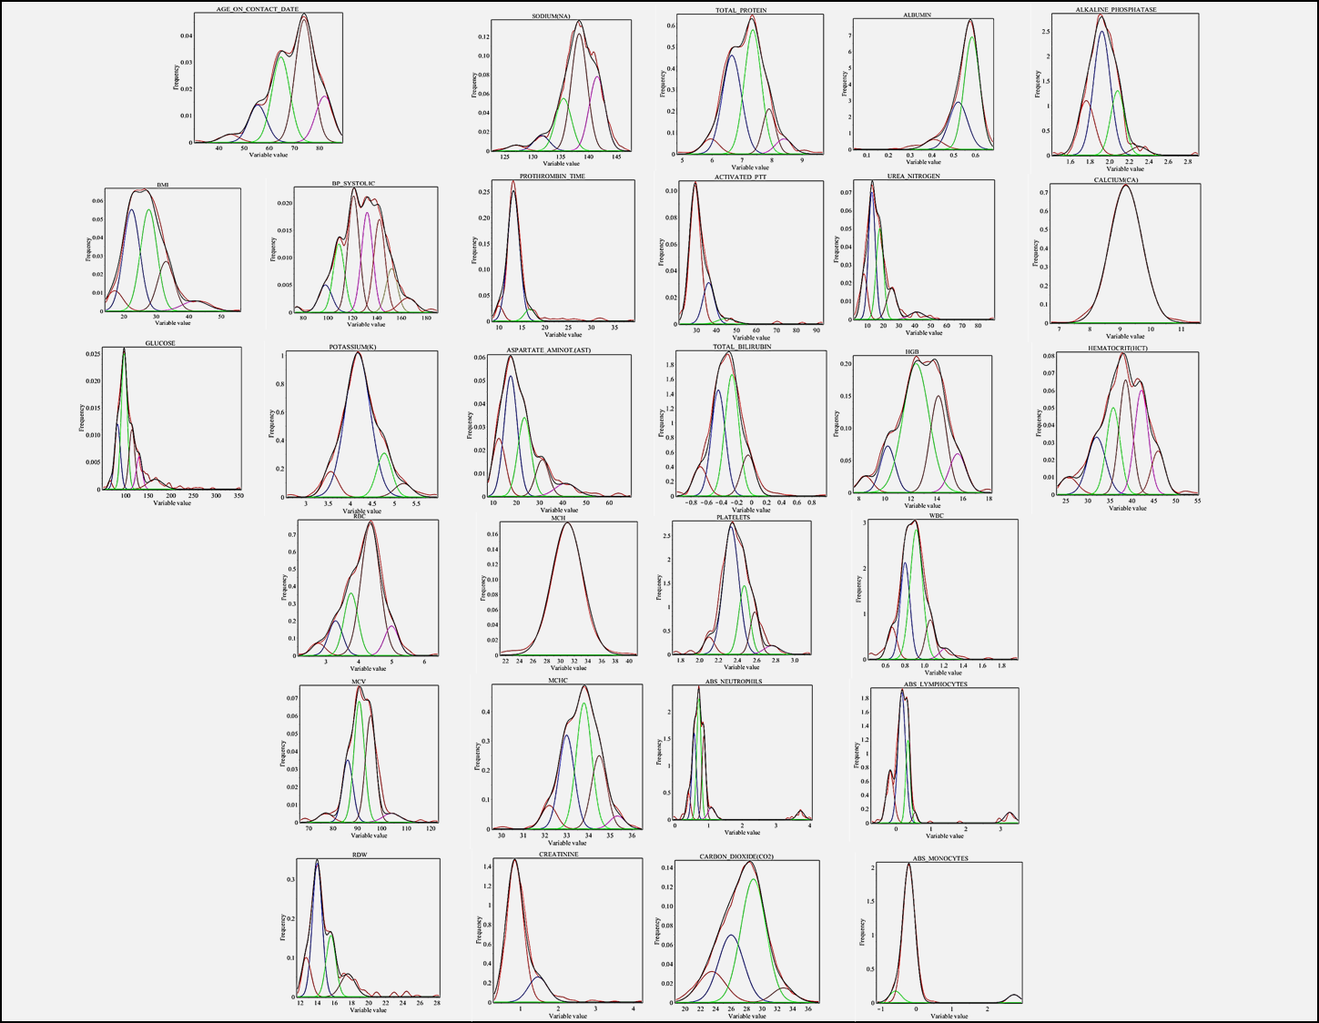
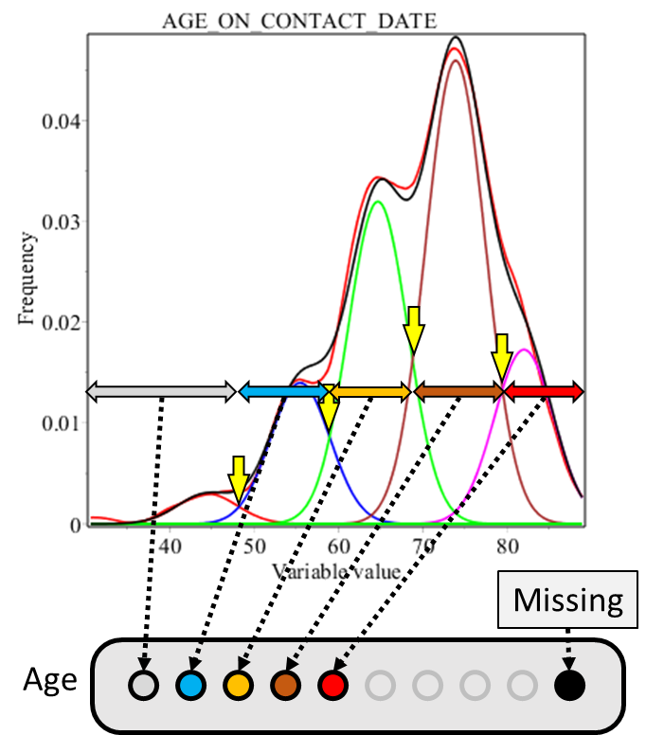
Value interval
Vertex

Slide 3
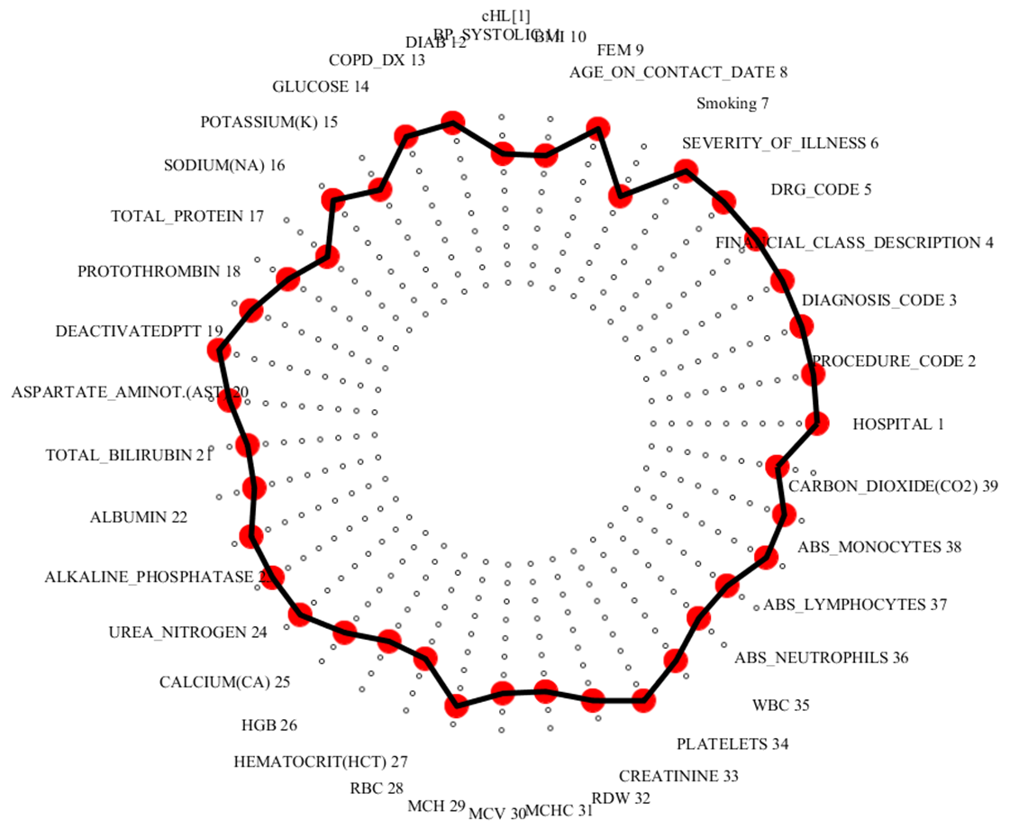
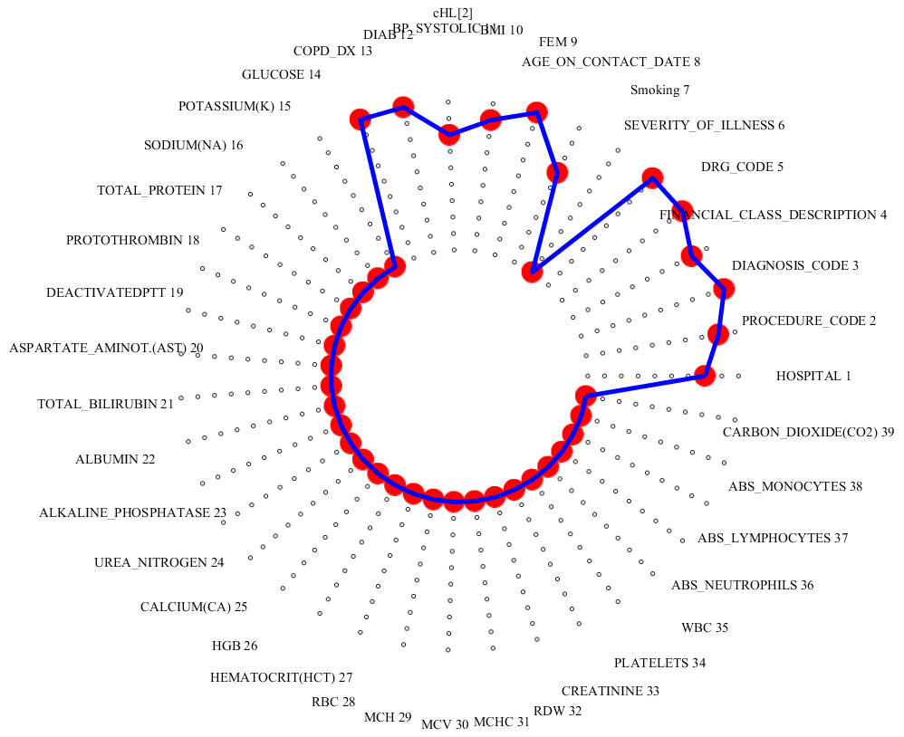
All data available
All but admission and demographic data missing
Graph representation of a personal clinical pattern preserves information about the value of missing clinical parameter in the relationships of remaining parameters = “natural imputation”
This imputation works until the missing data are not majority in the input information.
Problem is how to non-arbitrarily define “majority”.
By keeping the data for every patient together, our approach results in data-driven identification of the patients, whose information is incompatible with the majority od cases.

Slide 4
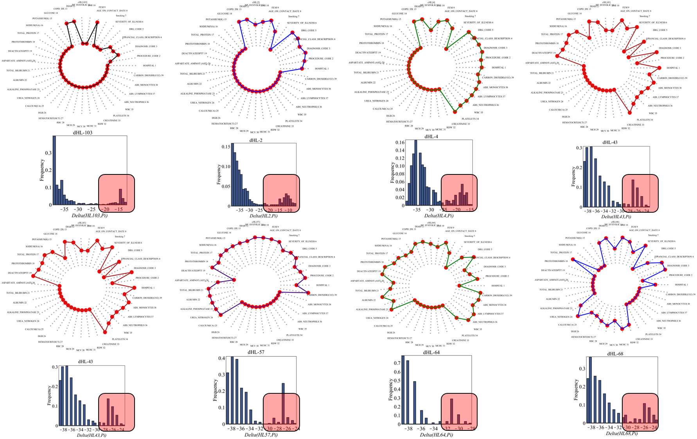
N_{all}=1667, N_{F} = 351 (21%), N_{S} = 1318
N_{D}=559 (33.5%) N_{DF} = 108 (19.3% of N_{D}) N_{DS} = 451 (34.2% of N_{S})

Slide 5
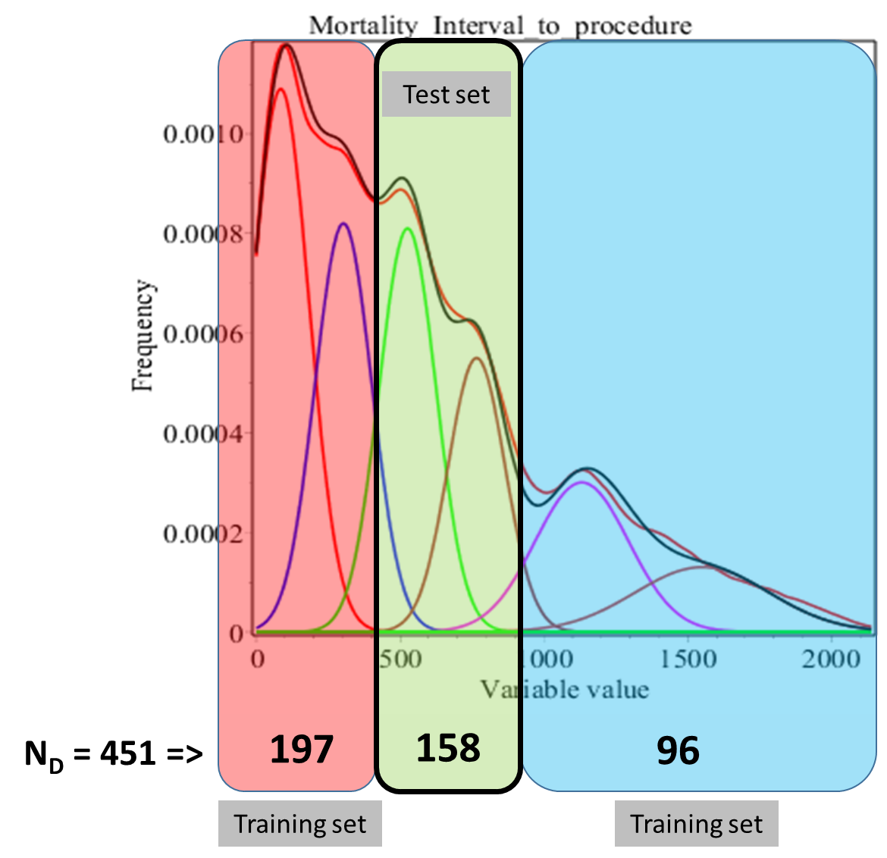
Rationale:
A. Mortality = known information.
B. Fact=Patients with the shortest survival and patients with the longest survival will have the largest differences in their clinical profiles.
C. If we can identify clinical patterns, discriminating between groups S and L, then proportions of these patterns in the personal clinical profile is quantitative marker (CPQM) of the disease severity.
2. Validation of clinical relevance of CPQM:
By demonstrating, that personal clinical profiles of patients with intermediate survival are mixes of S and L clinical patterns.
S
L

Slide 6
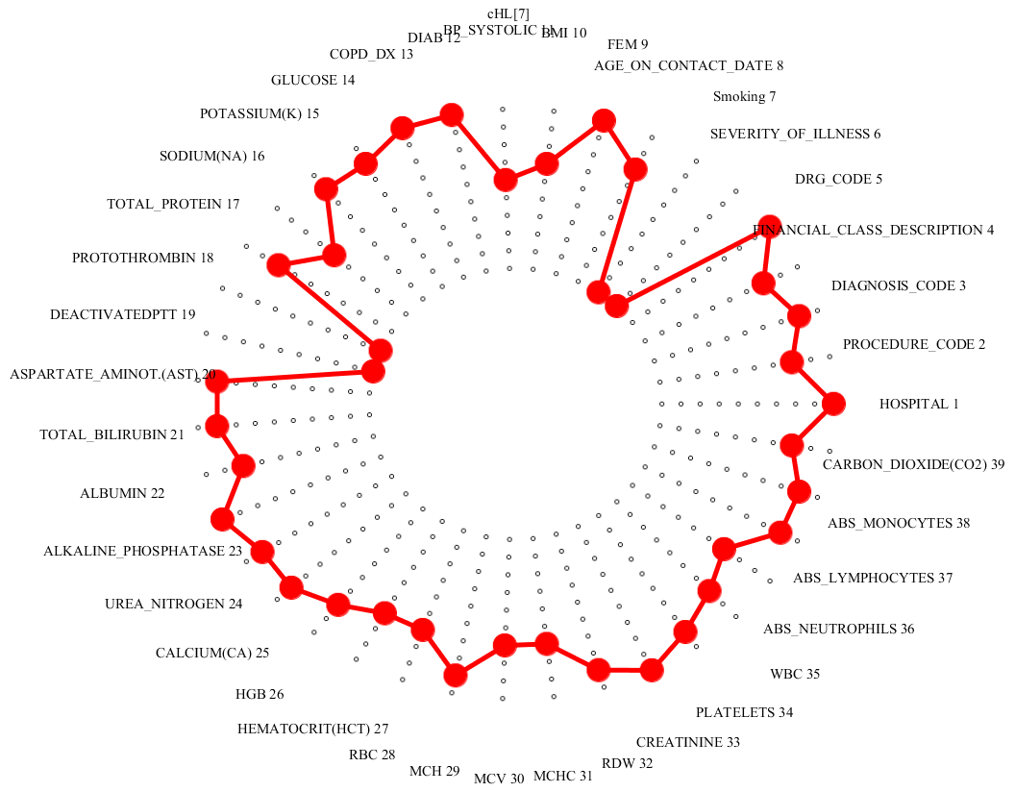
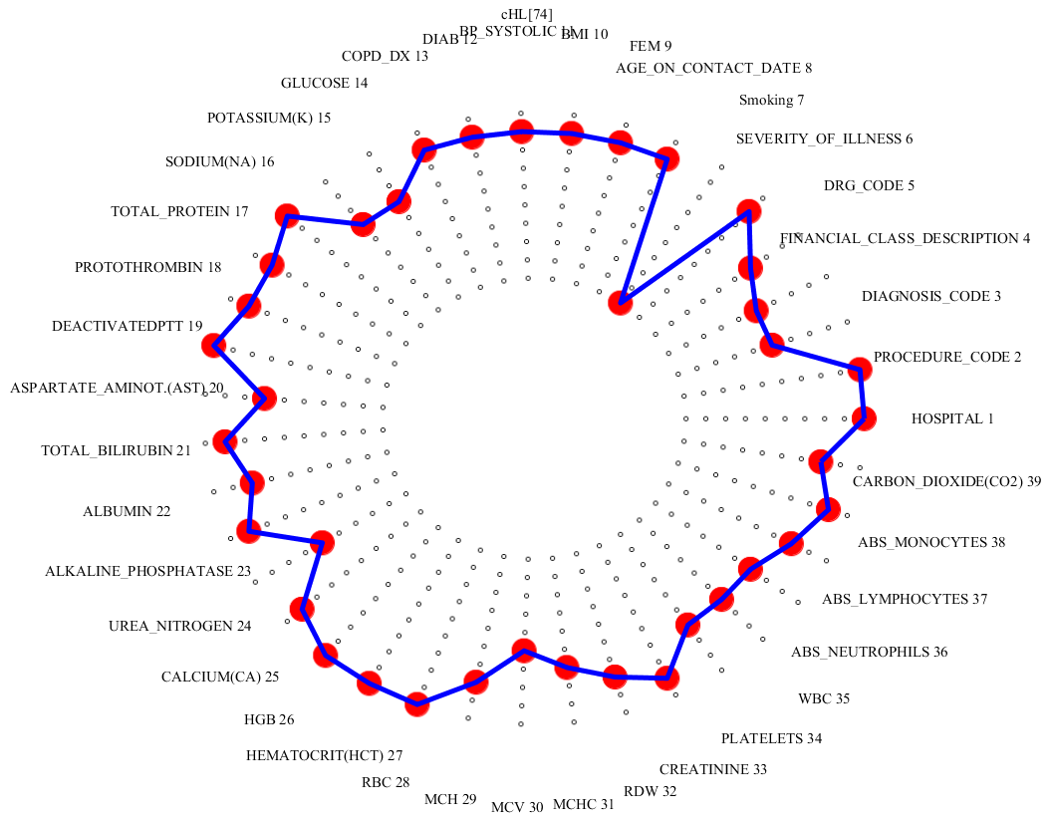
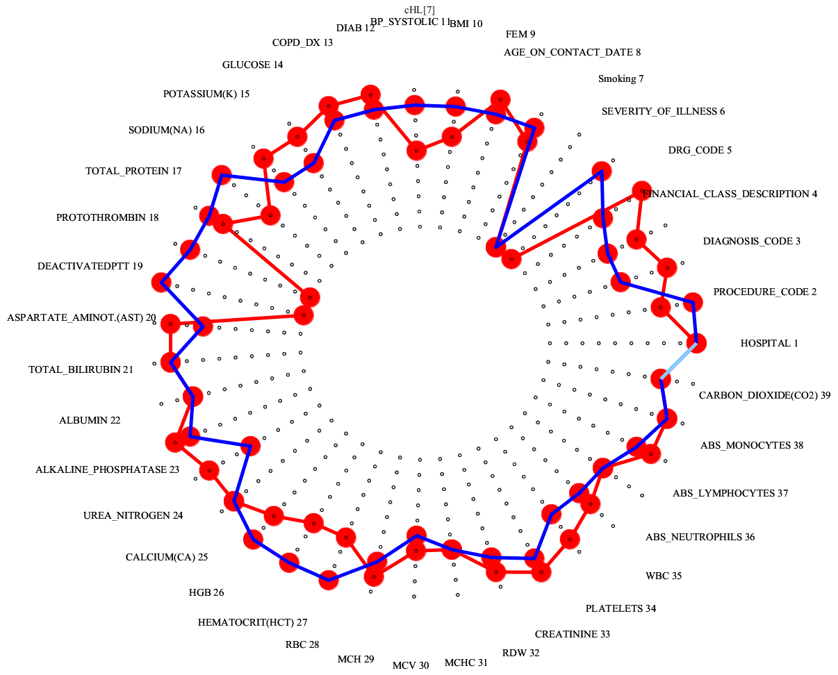
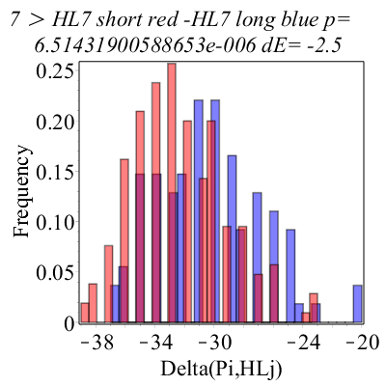
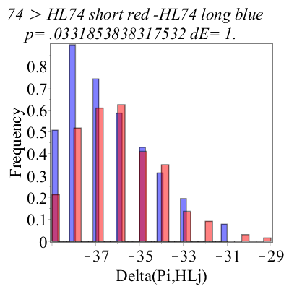
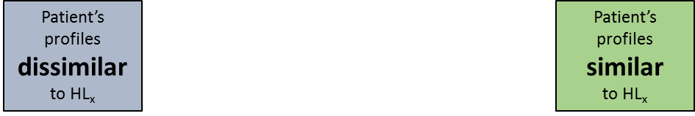
103 landmark clinical profiles (HL₁ … HL₁₀₃)
HL₇
Systematic search for clinical profile landmarks, “grouping” the S and L patients with the highest differentiation.
HL₇₄
HL₇
HL₇₄

Slide 7
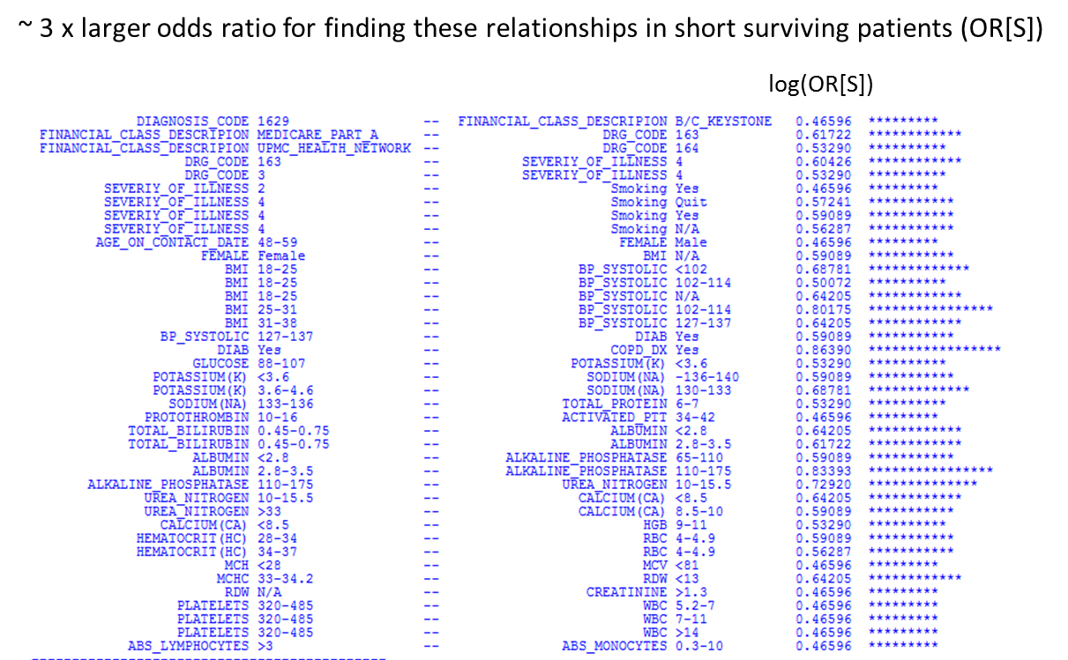
MCC = major complication or comorbidity, CC = complication or comorbidity
Malignant neoplasm of bronchus and lung, unspecified
MAJOR CHEST PROCEDURES W MCC
MAJOR CHEST PROCEDURES W CC
MAJOR CHEST PROCEDURES W MCC
ECMO OR TRACH W MV >96 HRS OR PDX EXC FACE, MOUTH &
NECK W MAJ O.R.

Slide 8
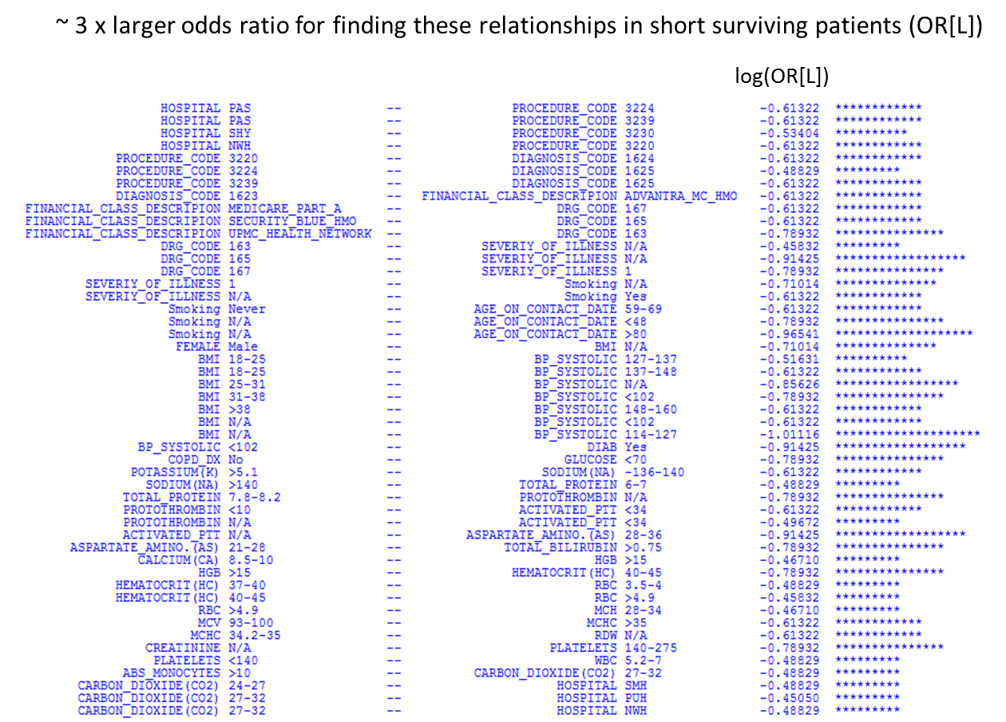
Perc abltn lung les/tiss
Destroy loc lung les NEC
Thorac seg lung resect
Thorac exc lung lesion
Perc abltn lung les/tiss
Malignant neoplasm of middle lobe, bronchus or lung
Destroy loc lung les NEC
Malignant neoplasm of lower lobe, bronchus or lung
Malignant neoplasm of upper lobe, bronchus or lung
OTHER RESP SYSTEM O.R. PROCEDURES W CC
MAJOR CHEST PROCEDURES W/O CC/MCC
MAJOR CHEST PROCEDURES W MCC
MAJOR CHEST PROCEDURES W MCC
MAJOR CHEST PROCEDURES W/O CC/MCC
OTHER RESP SYSTEM O.R. PROCEDURES W CC

Slide 9
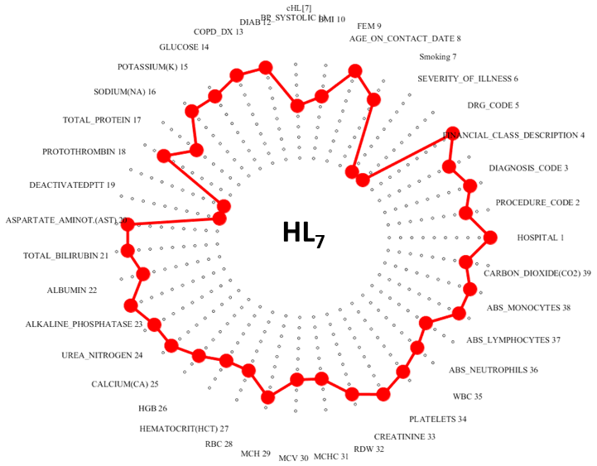
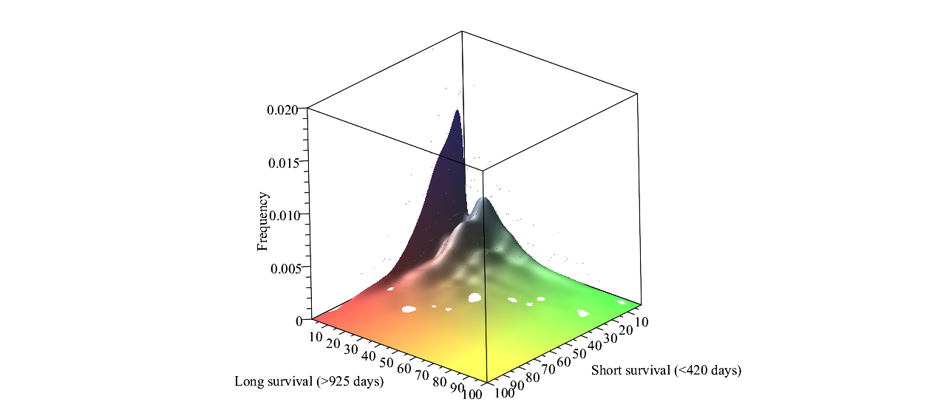
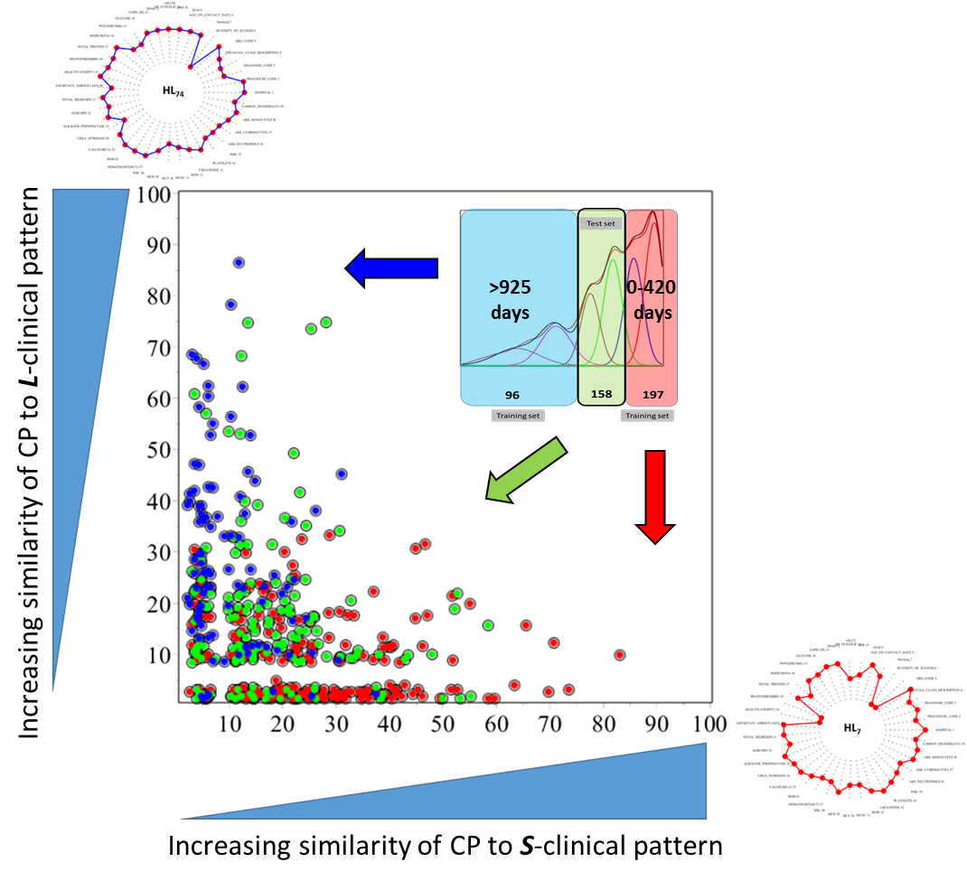
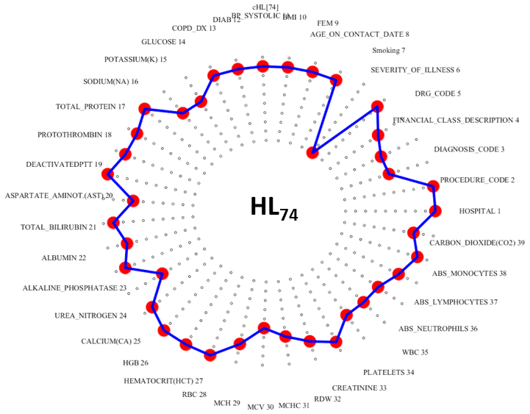
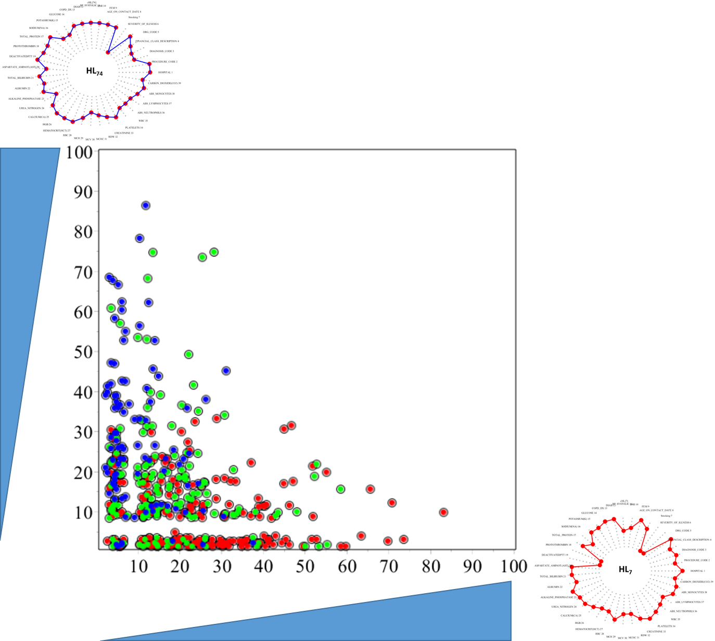
Visualization of the grouping of the S and L patients with the highest differentiation, identified by the significantly distinct differences and similarities of their clinical profiles to the two optimally clustering HL’s.
Results:
Validation of the hypothesis that patients with the intermediate survival will have clinical profiles, which are intermediate mixes of features (unique combinations of relationships between clinical parameter values) found in “extremal” clinical profiles, characteristic for S and L patients.
The results identifies natural, data driven boundaries between the patient subgroups = “valleys” in the histograms of patients with given clinical profiles.

Slide 10
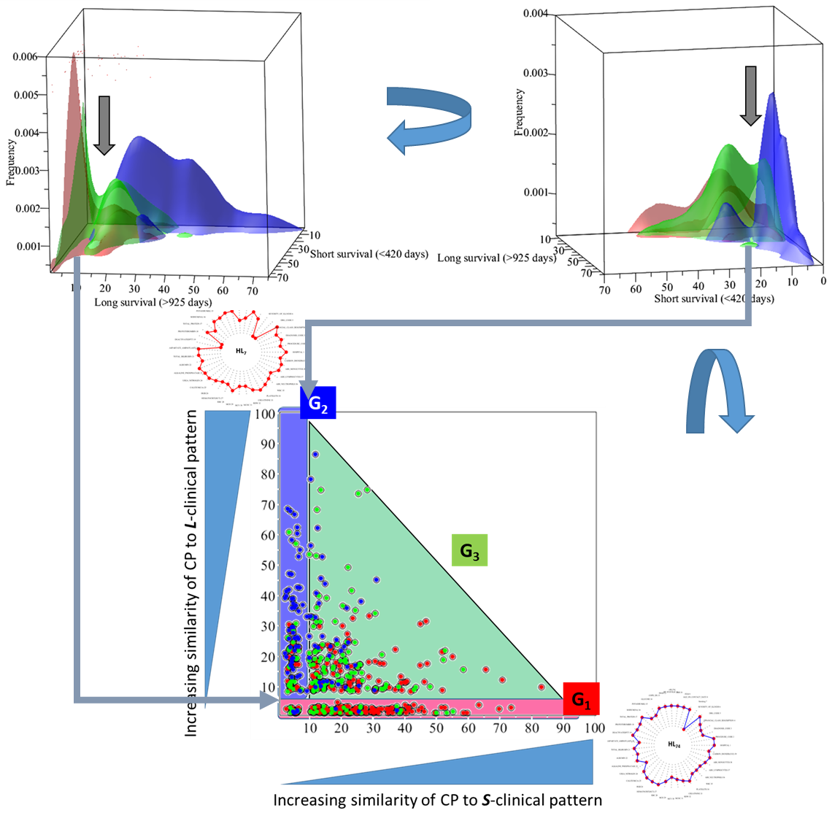

Slide 11
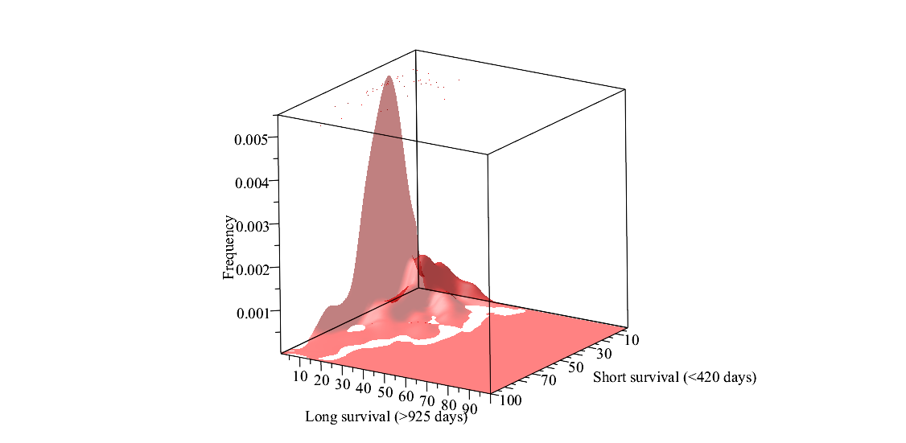
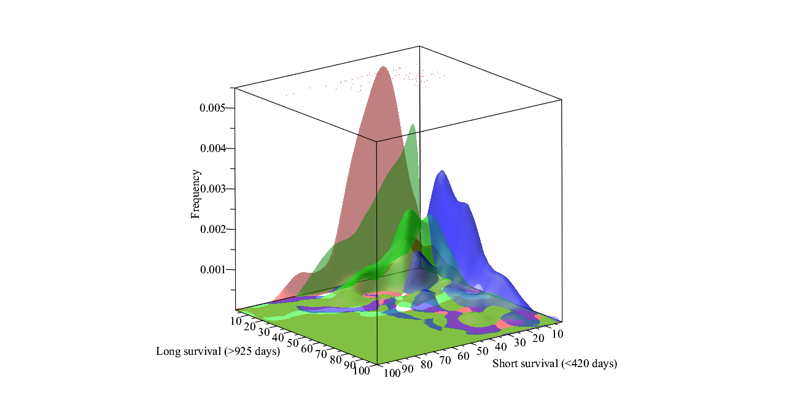
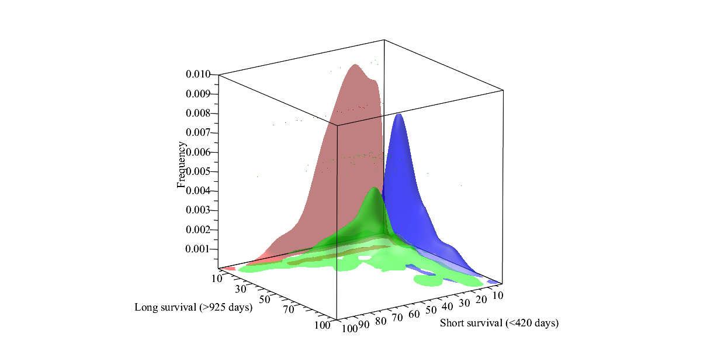
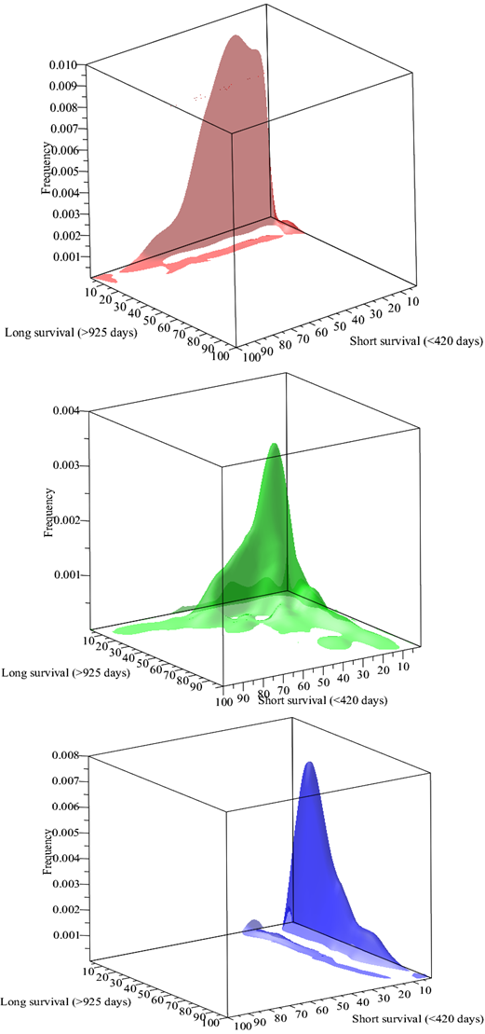
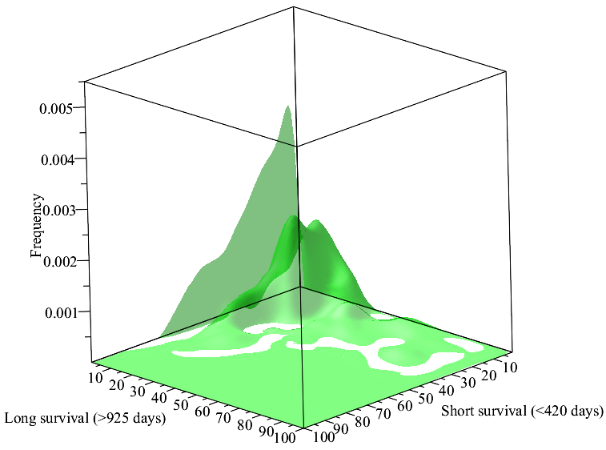
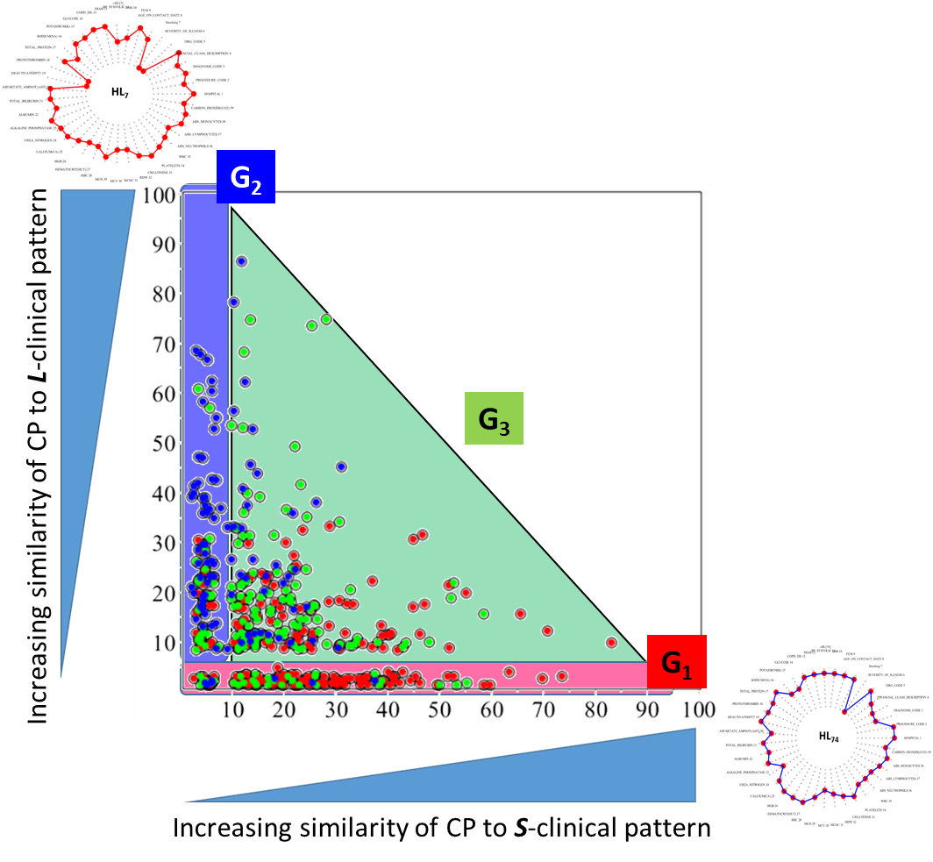
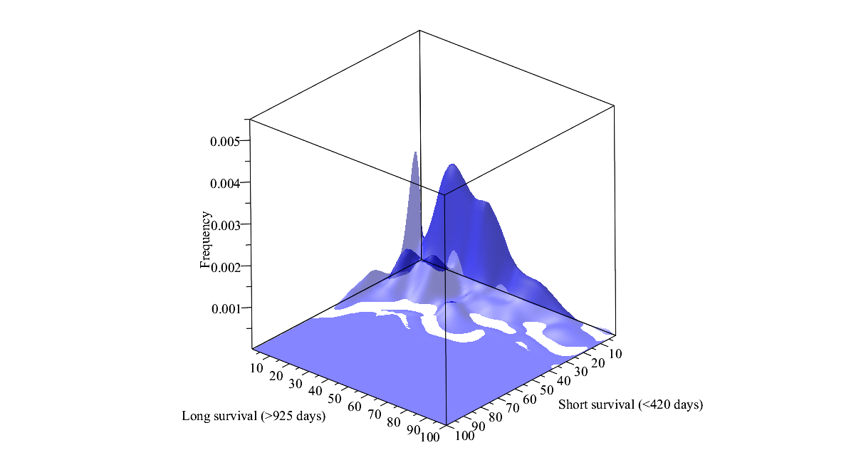
G₁
G₂
G₁
G₃
G₃
G₂

Slide 12
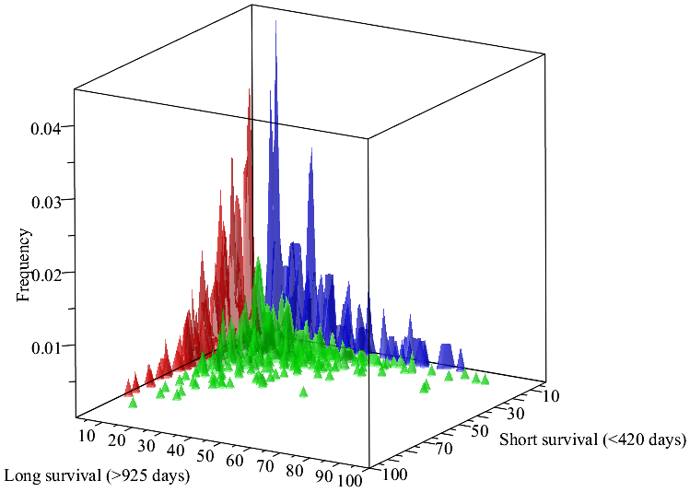
Complete set of N =1318 patients
This series of steps results in the straightforward algorithm, identifying for any patient the clinical subtypes G₁, G₂ or G₃ of the lung cancer:
G₁
G₂
397
n_{D} = 147
D_{S} = 37%
D_{T} = 11%
291
n_{D} = 90
D_{S} = 31%
D_{T} = 6.8%
Input pts data, convert to PCp
Compare adjacency matrices of PCp to stored matrices, representing HL’s and edge weights and compute x-y similarity coordinates
Identify where in boundaries PCp localizes – output G₁, G₂, G₃
Output the clinical features characterizing the severity group with highlighted ones that match patient’s PCp
630
n_{D}=214, D_{S} = 34%, D_{T} = 16.2%
G₃

Slide 13
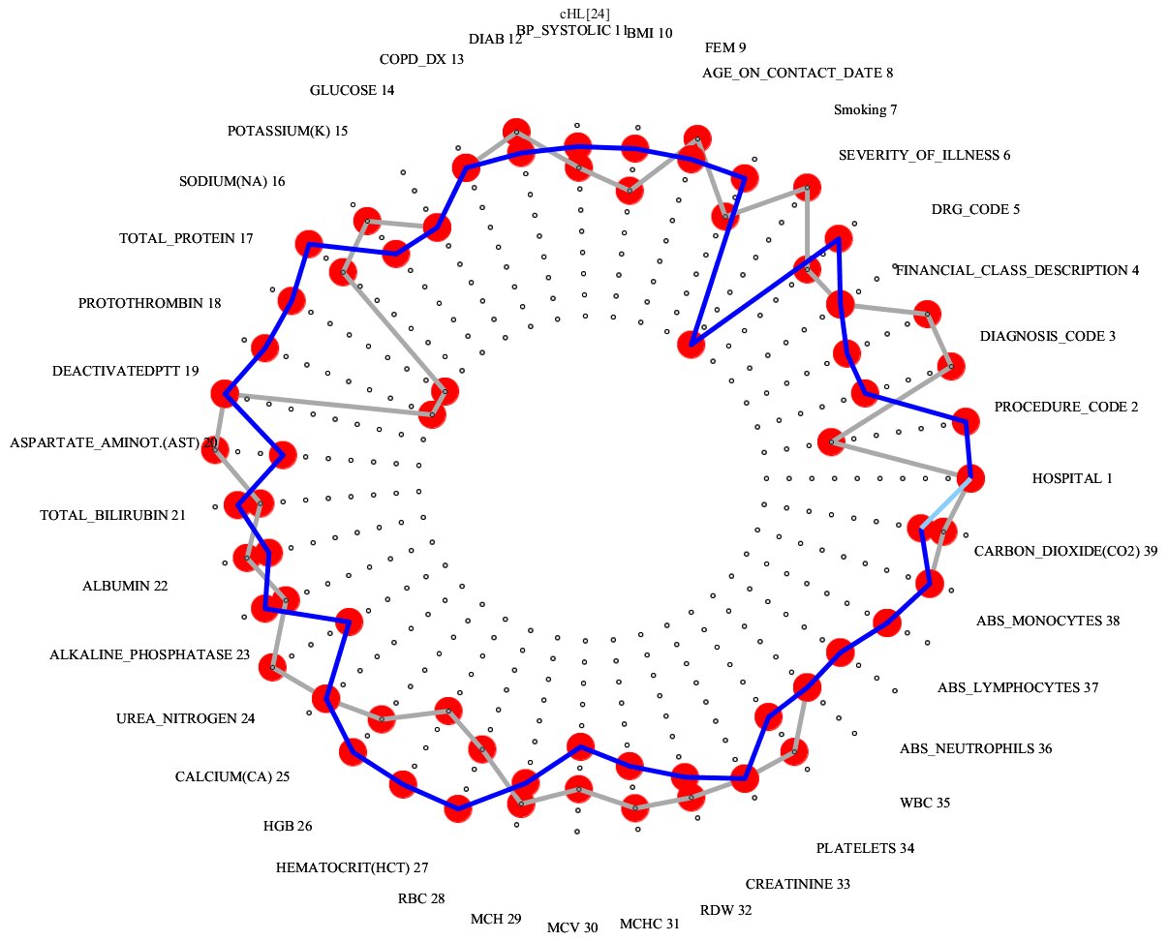

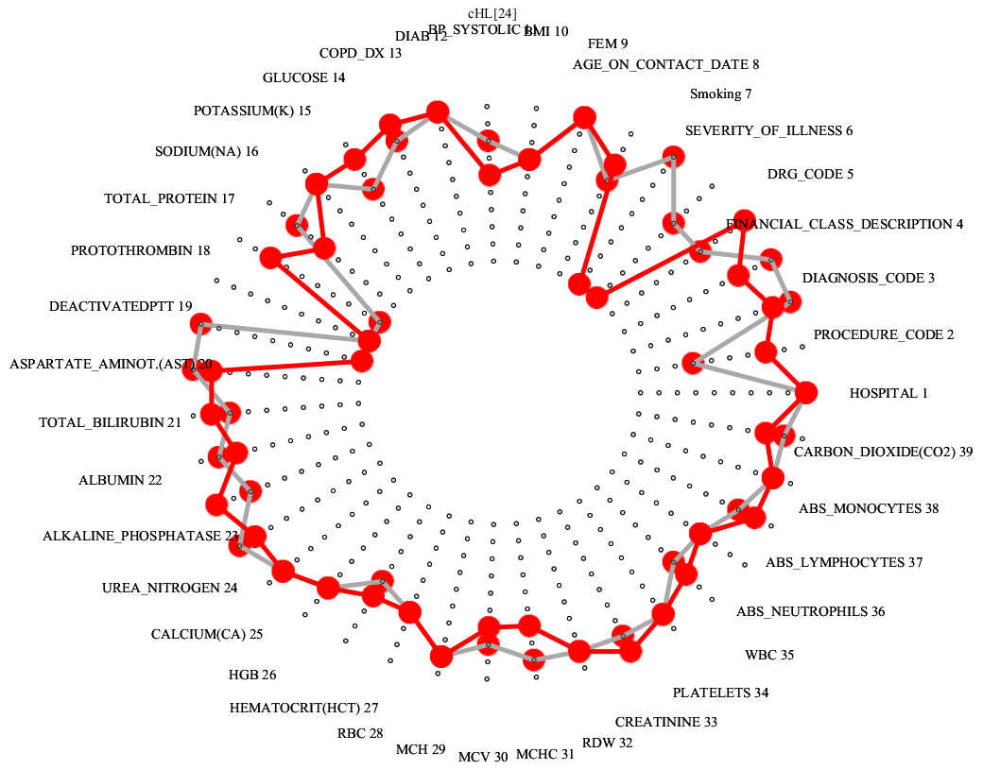
OVS model[G₁]
OVS model[G₂]
OVS model[G₃]

Slide 14
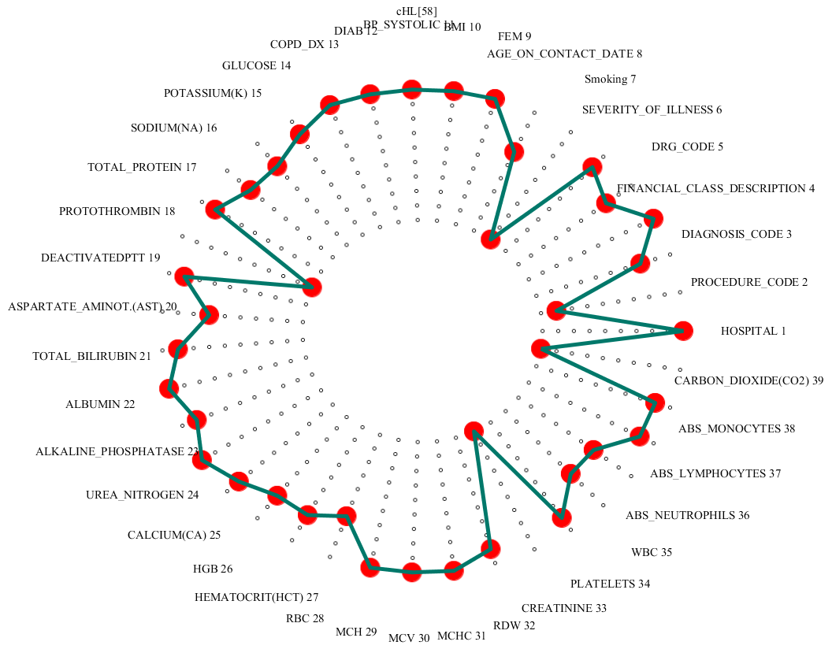
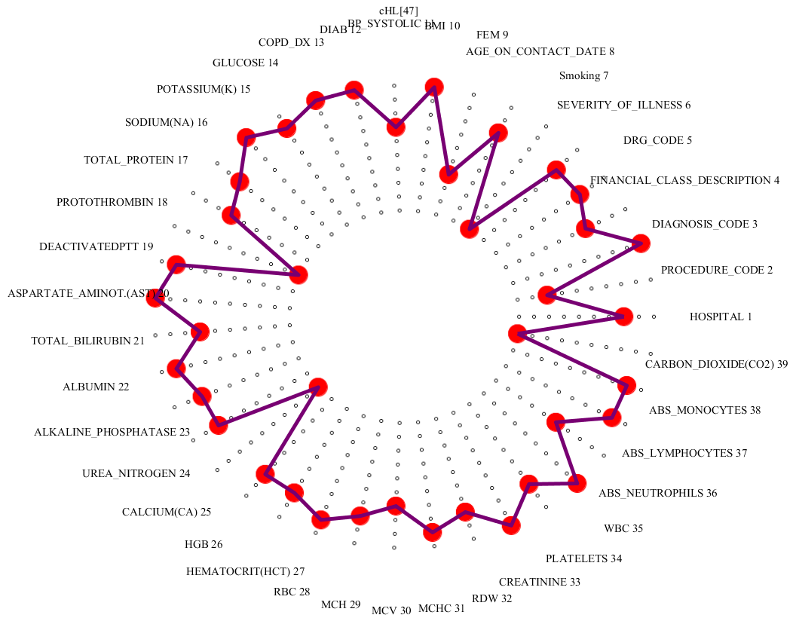
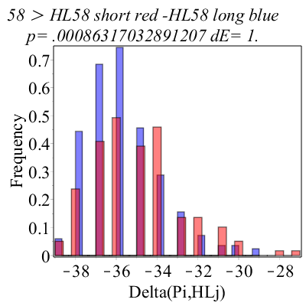
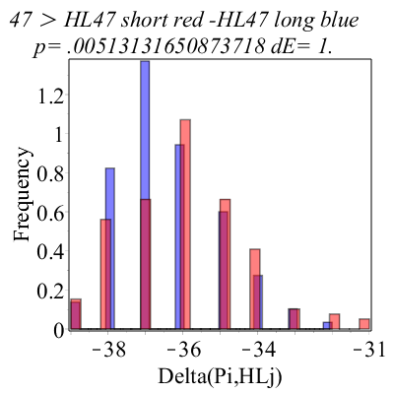
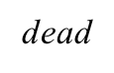
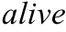
G₁
122 landmark clinical profiles (HL₁ … HL₁₂₂)
HL₅₈
Systematic search for clinical profile landmarks, “grouping” the D and A patients with the highest differentiation.
HL₄₇
alive
Patient’s profiles dissimilar to HL₅₈
Patient’s profiles similar
to HL₅₈
Patient’s profiles dissimilar to HL₄₇
Patient’s profiles similar
to HL₄₇

Slide 15
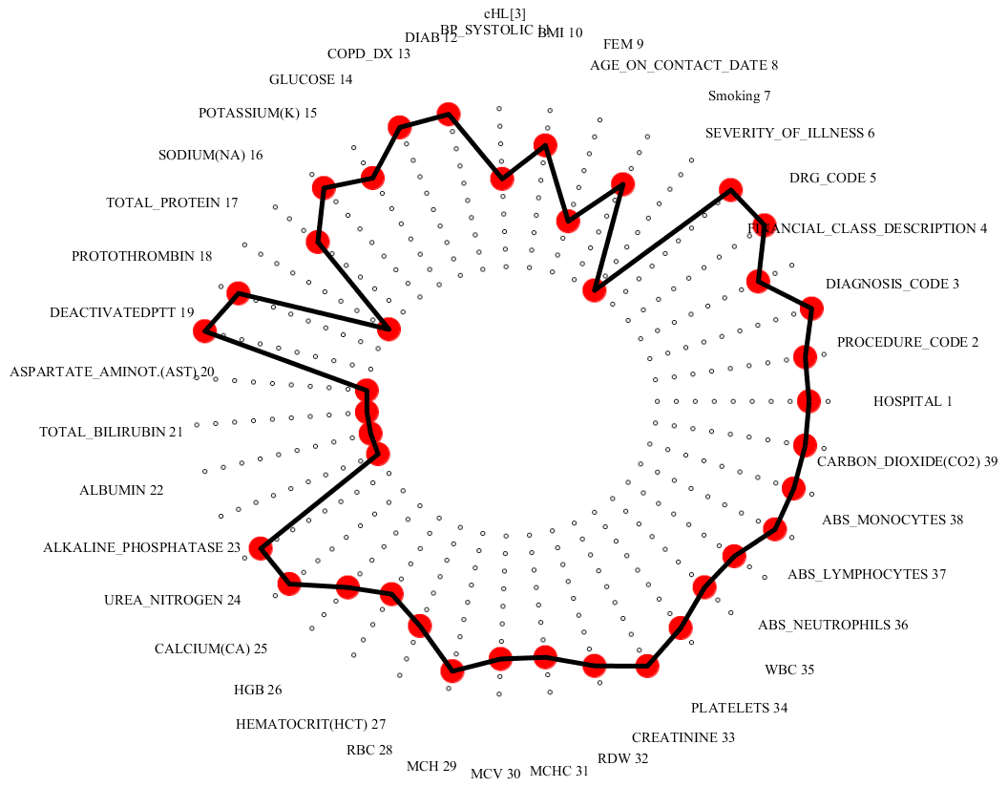
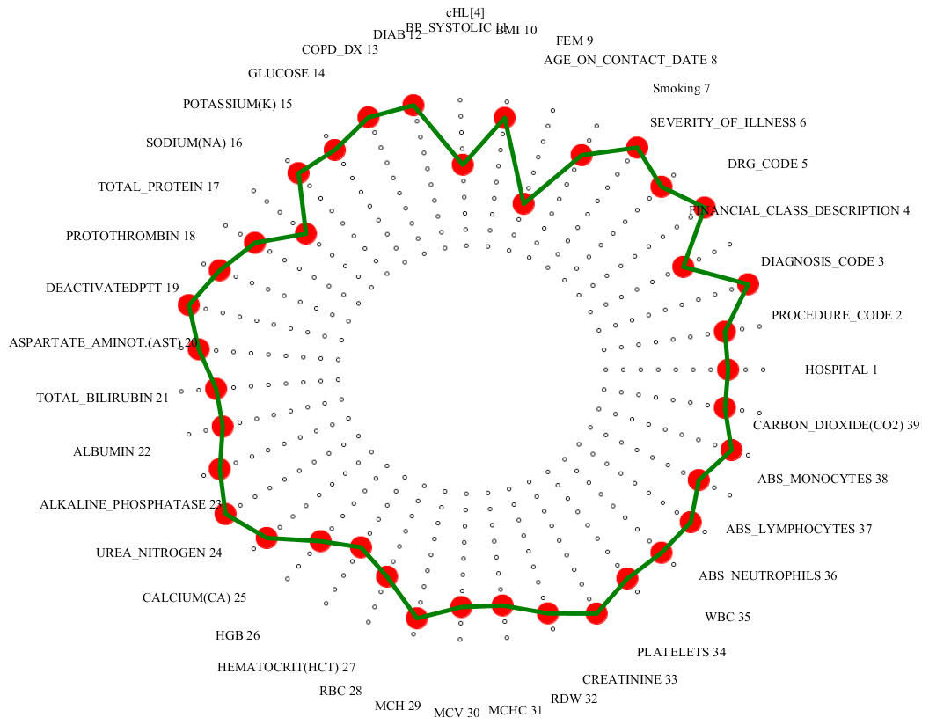
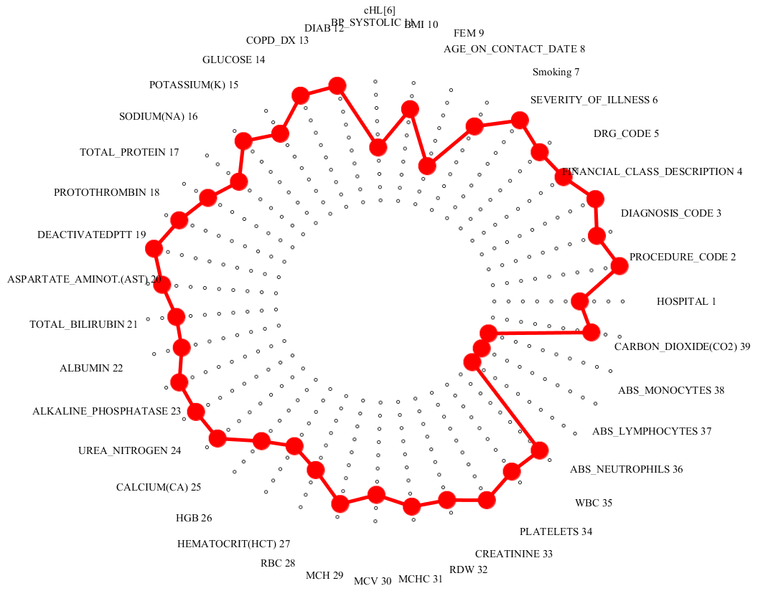
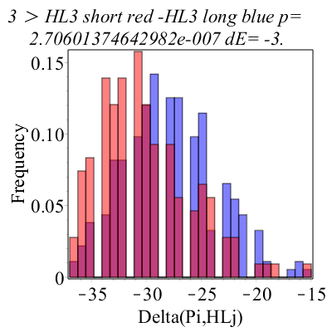
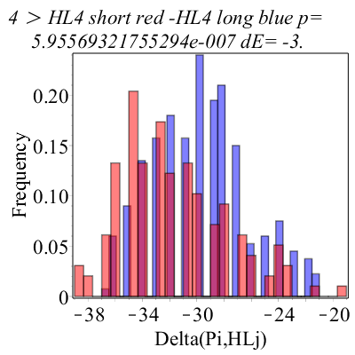
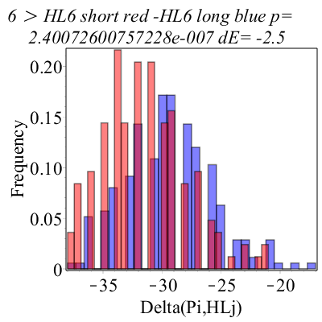
G₁
HL₃
HL₄
HL₆

Slide 16
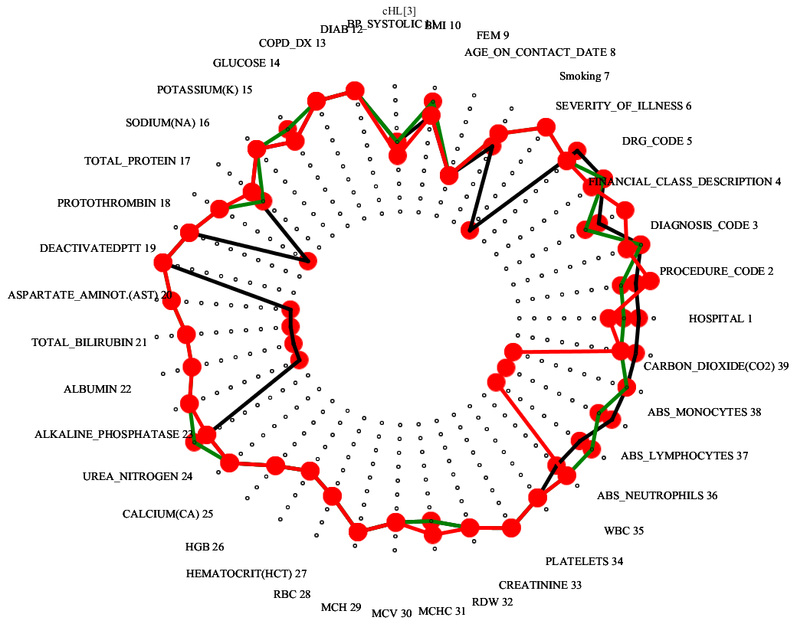
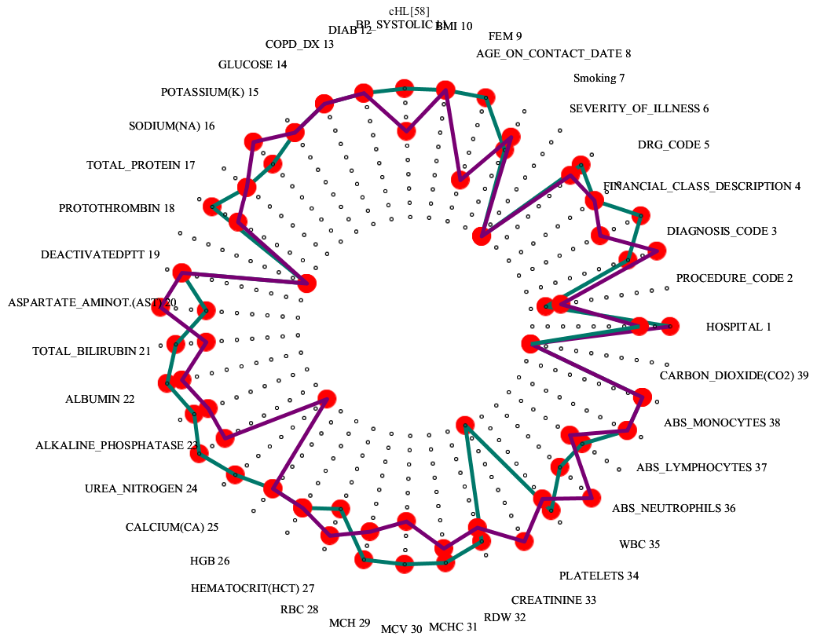
G₁
HL_{3,4,6}
HL_{47,58}

Slide 17
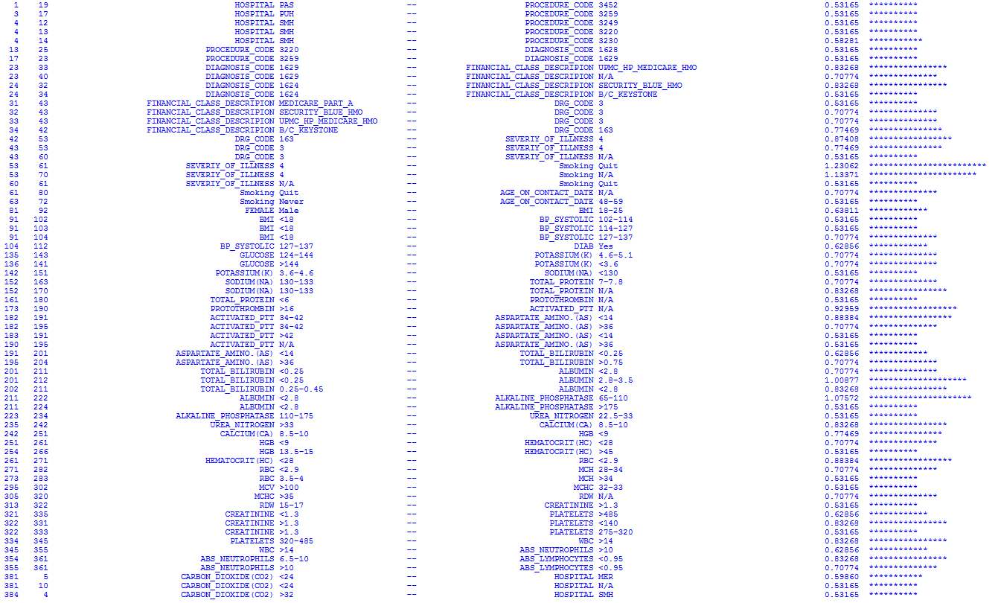
Relationships of clinical parameter values, characteristic for death in G₁
log(OR[D])
Thoracoscopc decort lung
Other pneumonectomy NOS
Lobectomy of lung NEC
Thorac exc lung lesion
Malignant neoplasm of other parts of bronchus or lung
Thorac seg lung resect
Malignant neoplasm of bronchus and lung, unspecified
Malignant neoplasm of bronchus and lung, unspecified
Malignant neoplasm of middle lobe, bronchus or lung
ECMO OR TRACH W MV >96 HRS OR PDX EXC FACE, MOUTH & NECK W MAJ O.R.
MAJOR CHEST PROCEDURES W MCC
MAJOR CHEST PROCEDURES W MCC
ECMO OR TRACH W MV >96 HRS OR PDX EXC FACE, MOUTH & NECK W MAJ O.R.

Slide 18
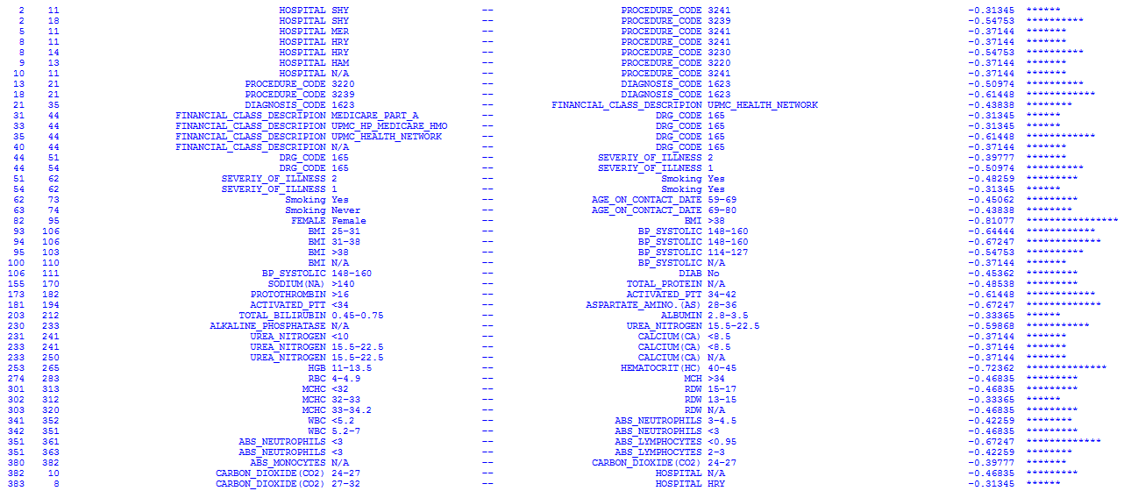
Relationships of clinical parameter values, characteristic for alive outcome in G₁
log(OR[D])
Thorac lobectomy lung
Oth seg lung resect NOS
Thorac lobectomy lung
Thorac seg lung resect
Thorac exc lung lesion
Thorac exc lung lesion
Thorac lobectomy lung
Malignant neoplasm of upper lobe, bronchus or lung
Oth seg lung resect NOS
Malignant neoplasm of upper lobe, bronchus or lung
MAJOR CHEST PROCEDURES W/O CC/MCC
MAJOR CHEST PROCEDURES W/O CC/MCC

Slide 19
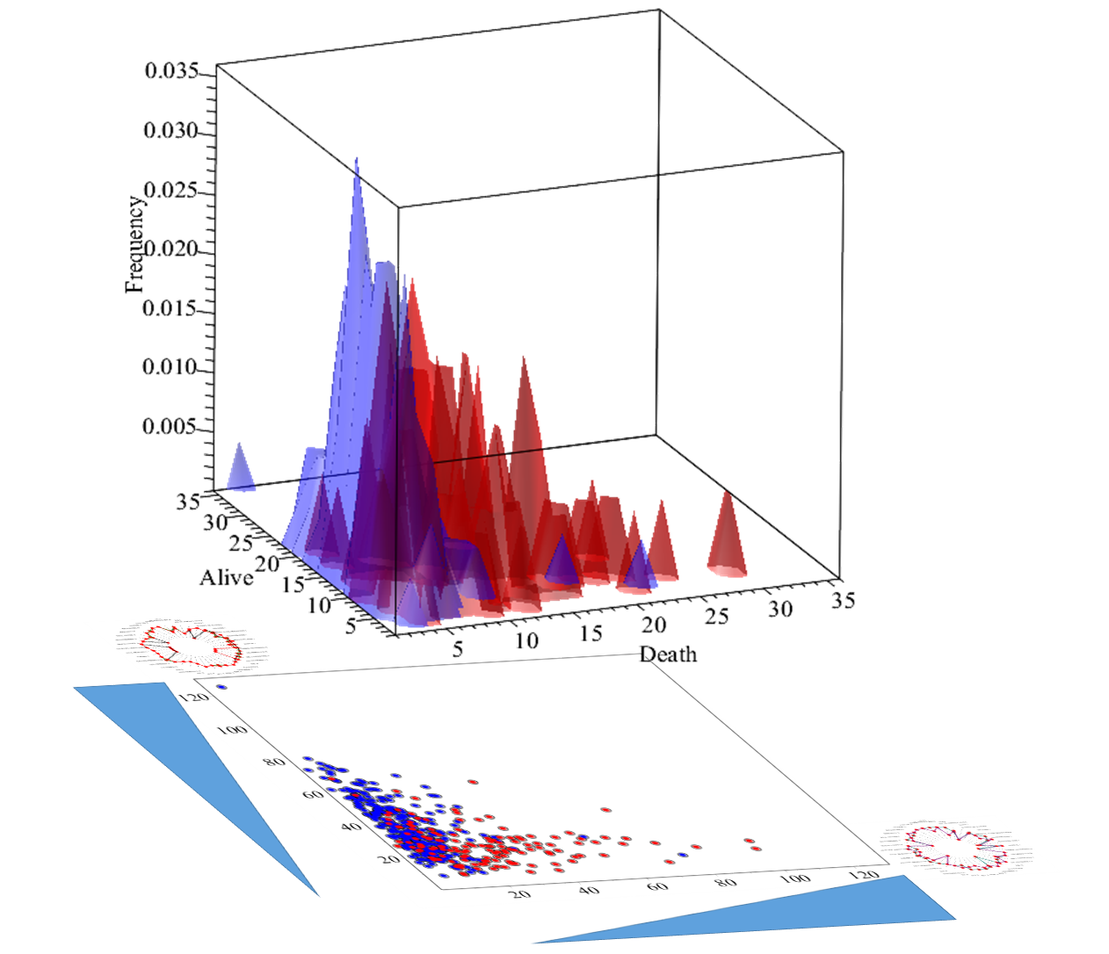
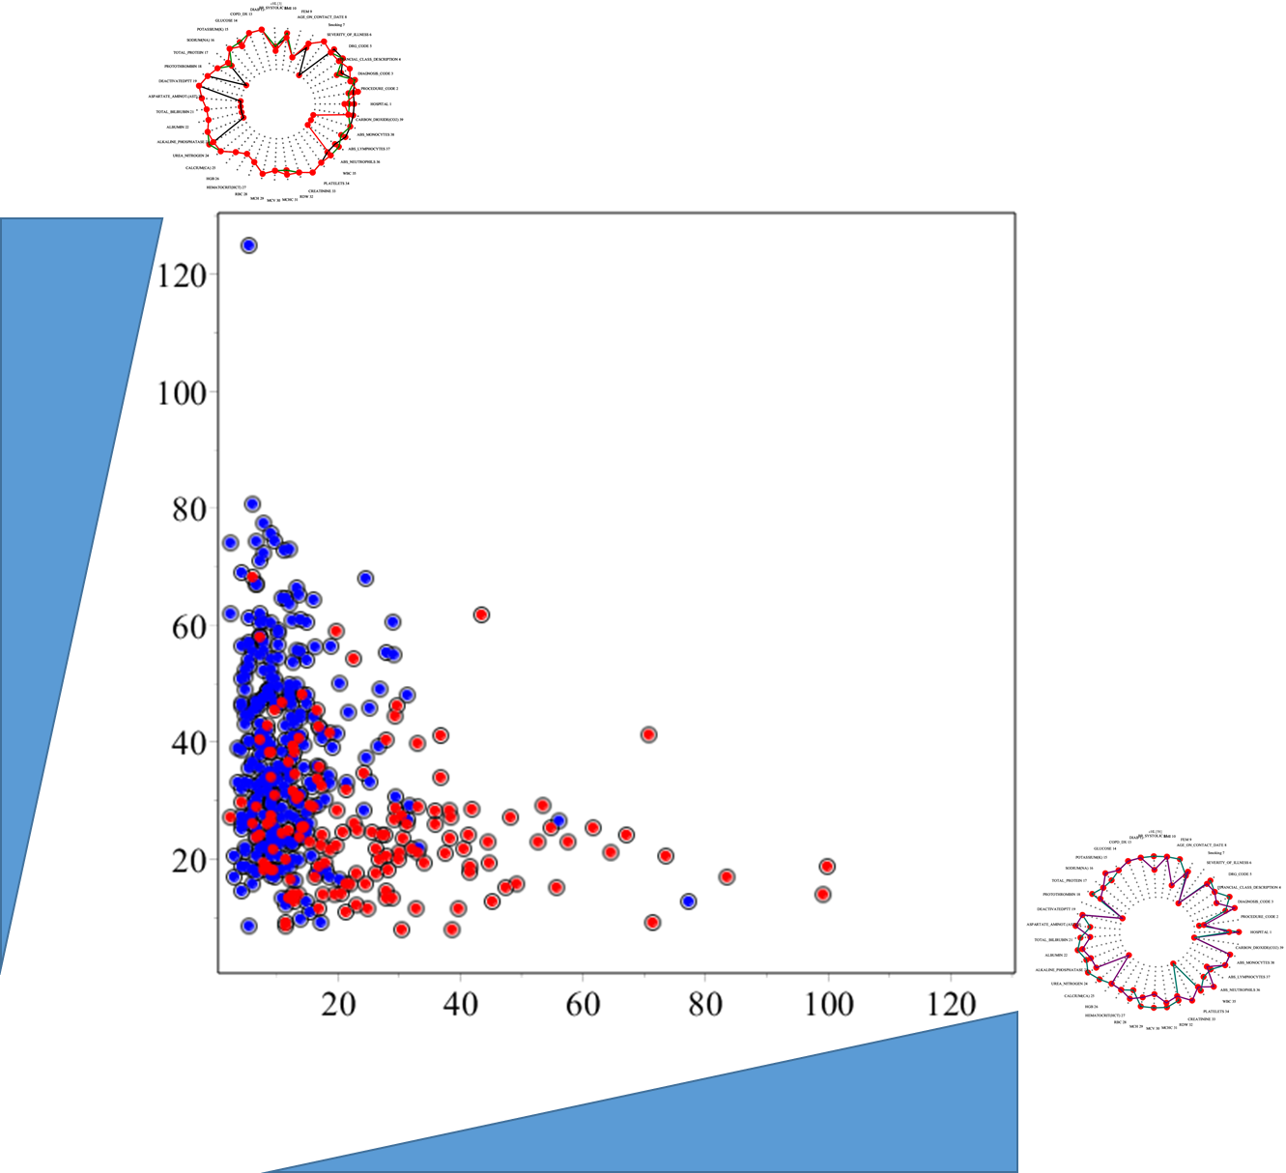
G₁
Compare adjacency matrices of PCp to stored matrices, representing G₁-specific informative HL’s and edge weights and compute x-y similarity coordinates
Identify where in red/blue (death/alive) boundaries PCp localizes – output odds for adverse event for the patient
Output the clinical features characterizing the death/alive section identified for the patient, with highlighted ones that match patient’s PCp
Model and algorithm, specific for G₁ patients, identifying odds for death after their lung cancer surgery
A_{(G1)}
Increasing similarity of PCP to alive-associated HL’s
D_{(G1)}
Increasing similarity of PCP to alive-associated HL’s
Increasing similarity of PCP to death-associated HL’s
Increasing similarity of PCP to death-associated HL’s

Slide 20
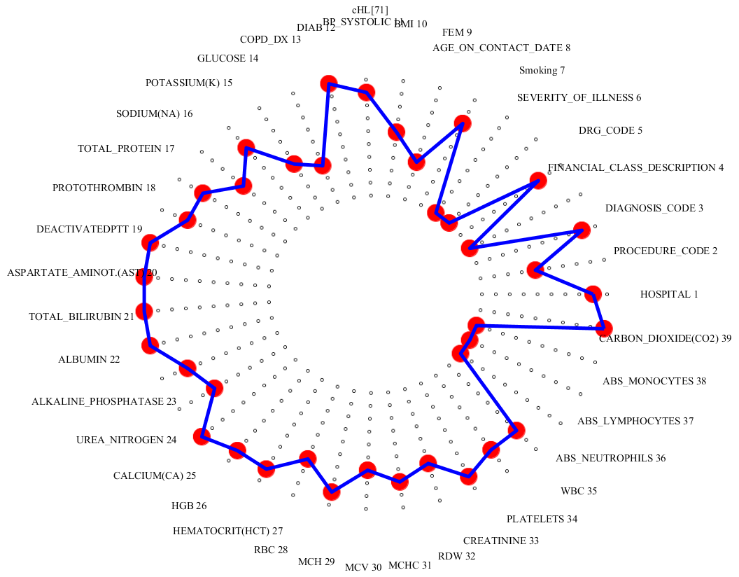



G₂
122 landmark clinical profiles (HL₁ … HL₁₂₂)
HL₇₁
Systematic search for clinical profile landmarks, “grouping” the D and A patients with the highest differentiation.
HL₅₉
Patient’s profiles dissimilar to HL₇₁
Patient’s profiles similar
to HL₇₁
Patient’s profiles dissimilar to HL₅₉
Patient’s profiles similar
to HL₅₉

Slide 21






G₂
HL₁₆
HL₁₄
HL₁

Slide 22


G₂
HL_{1,14,16}
HL_{59,71}

Slide 23

Relationships of clinical parameter values, characteristic for death in G₂
log(OR[D])
Perc abltn lung les/tiss
Destroy loc lung les NEC
Perc abltn lung les/tiss
Thorac exc lung lesion
Thorac seg lung resect
Malignant neoplasm of bronchus and lung, unspecified
Perc abltn lung les/tiss
Malignant neoplasm of upper lobe, bronchus or lung
Other pneumonectomy NOS
Malignant neoplasm of lower lobe, bronchus or lung
Malignant neoplasm of bronchus and lung, unspecified
OTHER RESP SYSTEM O.R. PROCEDURES W/O CC/MCC
ECMO OR TRACH W MV >96 HRS OR PDX EXC FACE, MOUTH & NECK W MAJ O.R.
OTHER RESP SYSTEM O.R. PROCEDURES W CC
ECMO OR TRACH W MV >96 HRS OR PDX EXC FACE, MOUTH & NECK W MAJ O.R.
MAJOR CHEST PROCEDURES W MCC
ECMO OR TRACH W MV >96 HRS OR PDX EXC FACE, MOUTH & NECK W MAJ O.R.
ECMO OR TRACH W MV >96 HRS OR PDX EXC FACE, MOUTH & NECK W MAJ O.R.
OTHER RESP SYSTEM O.R. PROCEDURES W CC
OTHER RESP SYSTEM O.R. PROCEDURES W/O CC/MCC

Slide 24

Relationships of clinical parameter values, characteristic for alive outcome in G₂
log(OR[D])
Thorac lobectomy lung
Thorac seg lung resect
Oth seg lung resect NOS
Thorac lobectomy lung
Malignant neoplasm of lower lobe, bronchus or lung
Thorac seg lung resect
Malignant neoplasm of bronchus and lung, unspecified
Malignant neoplasm of middle lobe, bronchus or lung
MAJOR CHEST PROCEDURES W/O CC/MCC
MAJOR CHEST PROCEDURES W CC
MAJOR CHEST PROCEDURES W/O CC/MCC
MAJOR CHEST PROCEDURES W CC
MAJOR CHEST PROCEDURES W/O CC/MCC

Slide 25





G₂
Compare adjacency matrices of PCp to stored matrices, representing G₂-specific informative HL’s and edge weights and compute x-y similarity coordinates
Identify where in red/blue (death/alive) boundaries PCp localizes – output odds for adverse event for the patient
Output the clinical features characterizing the death/alive section identified for the patient, with highlighted ones that match patient’s PCp
Model and algorithm, specific for G₂ patients, identifying odds for death after their lung cancer surgery
A_{(G2)}
D_{(G2)}

Slide 26




G₃
122 landmark clinical profiles (HL₁ … HL₁₂₂)
HL₇₁
Systematic search for clinical profile landmarks, “grouping” the D and A patients with the highest differentiation.
HL₄₈
Patient’s profiles dissimilar to HL₇₁
Patient’s profiles similar
to HL₇₁
Patient’s profiles dissimilar to HL₄₈
Patient’s profiles similar
to HL₄₈

Slide 27






G₃
HL₃
HL₁₆
HL₁

Slide 28


HL_{1,3,16}
HL_{48,71}

Slide 29

Relationships of clinical parameter values, characteristic for death in G₃
log(OR[D])
Perc abltn lung les/tiss
Destroy loc lung les NEC
Thorac exc lung lesion
Perc abltn lung les/tiss
Thorac exc lung lesion
Destroy loc lung les NEC
Malignant neoplasm of upper lobe, bronchus or lung
Malignant neoplasm of lower lobe, bronchus or lung
Malignant neoplasm of lower lobe, bronchus or lung
Malignant neoplasm of bronchus and lung, unspecified
Malignant neoplasm of bronchus and lung, unspecified
OTHER RESP SYSTEM O.R. PROCEDURES W CC
MAJOR CHEST PROCEDURES W CC
MAJOR CHEST PROCEDURES W MCC
MAJOR CHEST PROCEDURES W MCC

Slide 30

Relationships of clinical parameter values, characteristic for alive outcome in G₃
log(OR[D])
Thorac lobectomy lung
Thorac seg lung resect
Perc abltn lung les/tiss
Thorac lobectomy lung
Malignant neoplasm of upper lobe, bronchus or lung
Malignant neoplasm of upper lobe, bronchus or lung
Malignant neoplasm of lower lobe, bronchus or lung
Malignant neoplasm of lower lobe, bronchus or lung
Malignant neoplasm of bronchus and lung, unspecified
MAJOR CHEST PROCEDURES W/O CC/MCC
MAJOR CHEST PROCEDURES W MCC
MAJOR CHEST PROCEDURES W CC
MAJOR CHEST PROCEDURES W/O CC/MCC

Slide 31





G₃
Compare adjacency matrices of PCp to stored matrices, representing G₃-specific informative HL’s and edge weights and compute x-y similarity coordinates
Identify where in red/blue (death/alive) boundaries PCp localizes – output odds for adverse event for the patient
Output the clinical features characterizing the death/alive section identified for the patient, with highlighted ones that match patient’s PCp
Model and algorithm, specific for G₃ patients, identifying odds for death after their lung cancer surgery
A_{(G3)}
Increasing similarity of PCP to alive-associated HL’s
D_{(G3)}
Increasing similarity of PCP to death-associated HL’s

Slide 32




A_{(G1)}
D_{(G1)}
A_{(G2)}
D_{(G2)}
A_{(G3)}
D_{(G3)}

